Slide 1
Centralized Purchasing Module

Slide 2
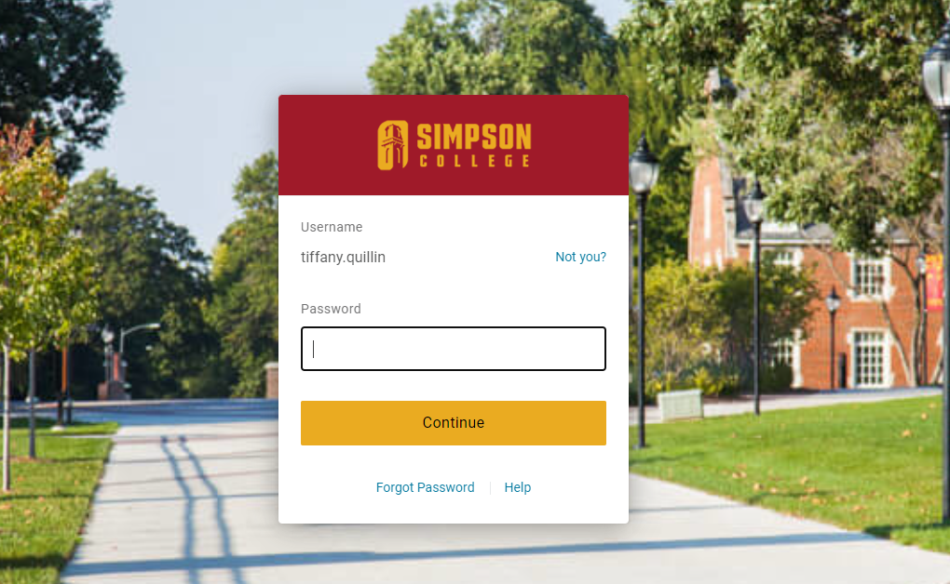
Step 1: Log into Simpson One Login

Slide 3
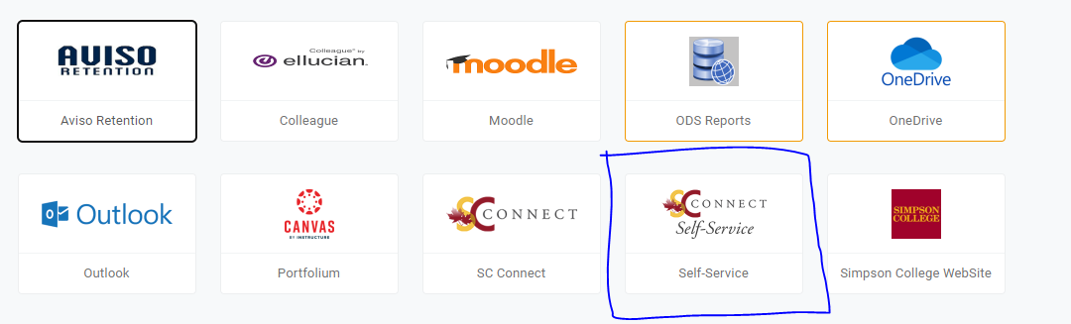
Step 2: Log into Self-Service

Slide 4
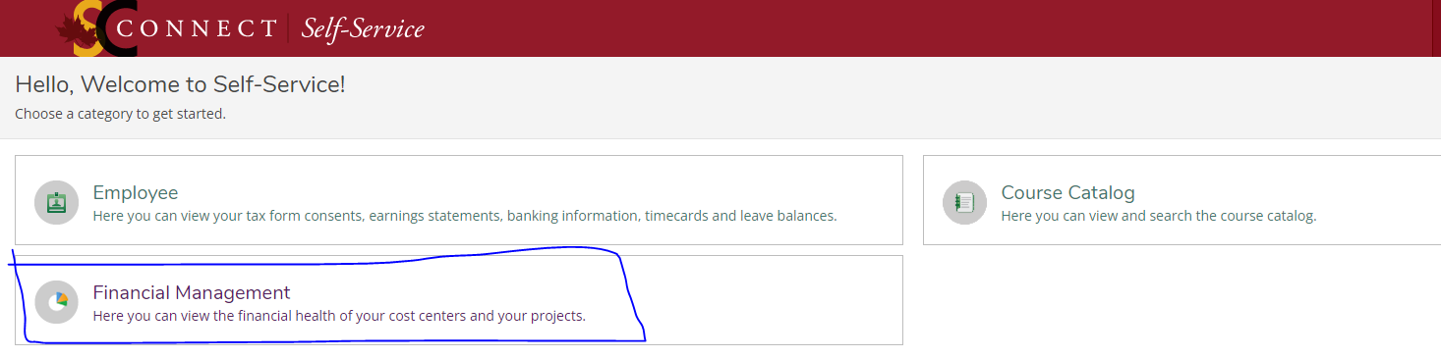
Step 3: Click on Financial Management

Slide 5
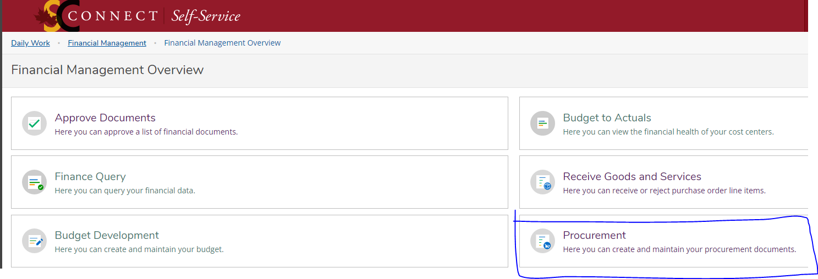
Step 4: Click on Procurement

Slide 6
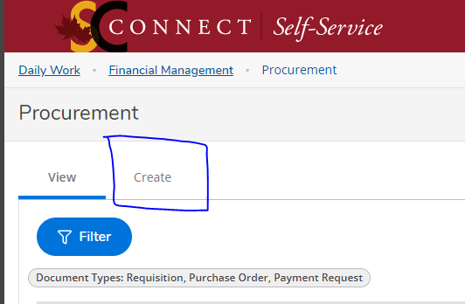
Step 5: Click on the “Create” Tab

Slide 7
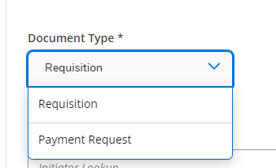
Step 6: Choose the document type: Requisition or Payment Request
Requestions are for purchasing goods/services. Payment Requests are used for Reimbursements/Travel Expenses.

Slide 8
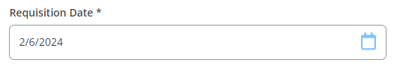
Step 7: Select requisition date:
This date should be the date on the quote, or the day of travel/purchase for reimbursements. If doing a multiple day travel reimbursement, use the last day traveled.

Slide 9
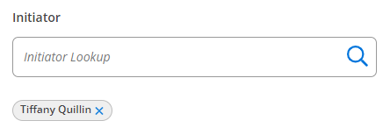
Step 8: Initiator will default to the person submitting.
*Do not change this*

Slide 10
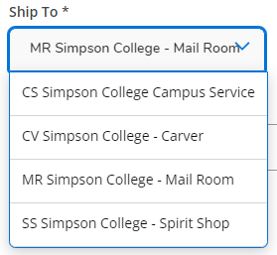
Step 9: Select a shipping address

Slide 11
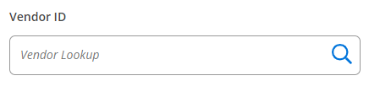
Step 10: Type in vendor name
You will use this number to name any documentation you attach.

Slide 12
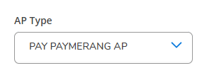
Step 11: AP Type will fill in automatically- DO NOT CHANGE THIS

Slide 13
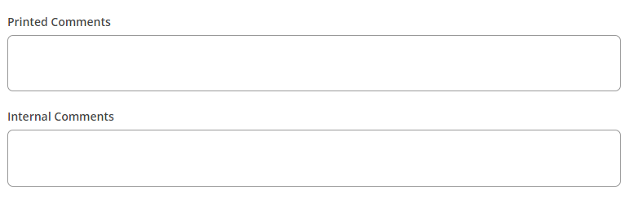
Step 12: Type any comments you have about this order:
Printed will appear on all printed paperwork; internal will only be in computer notes.
Examples: Directions for PO(email/faxing to vendor (need contact info), Invoice status-if known. The more details provided, the better.

Slide 14
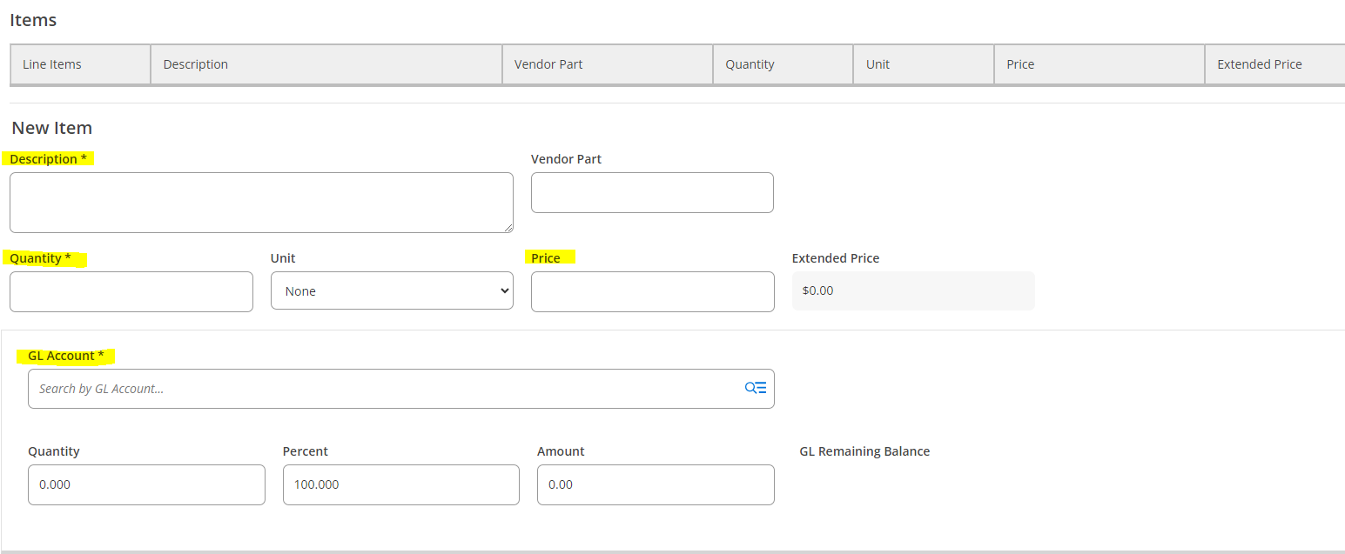
Step 13: Add items-
Be as detailed as possible. Required fields highlighted.

Slide 15
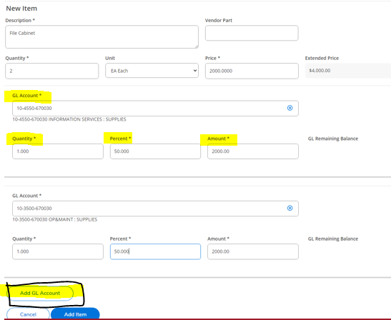
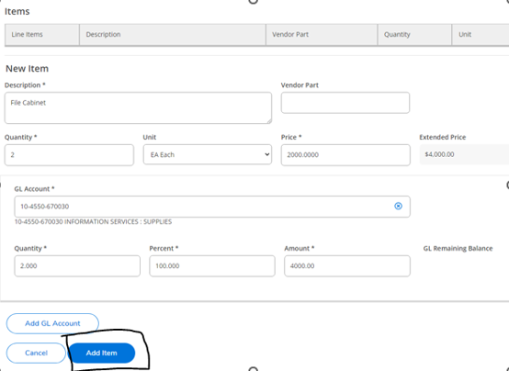
To add multiple line items, click the “Add Item” until you have added all the items you need to.
If splitting a line item into multiple GL lines, click “Add GL Account.” You can divide these up by percentage or dollar amount.

Slide 16
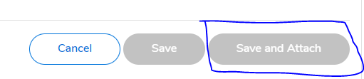
Step 14: Once all items are added, click save and attach. This will submit the form. You can go back and edit if necessary. All documents needed to be saved under the format below:
Document type_vendor number_date on document
Example: INV_1234567_3.21.24
INV=Invoice
QUOTE=Quote
EST=Estimate

Slide 17
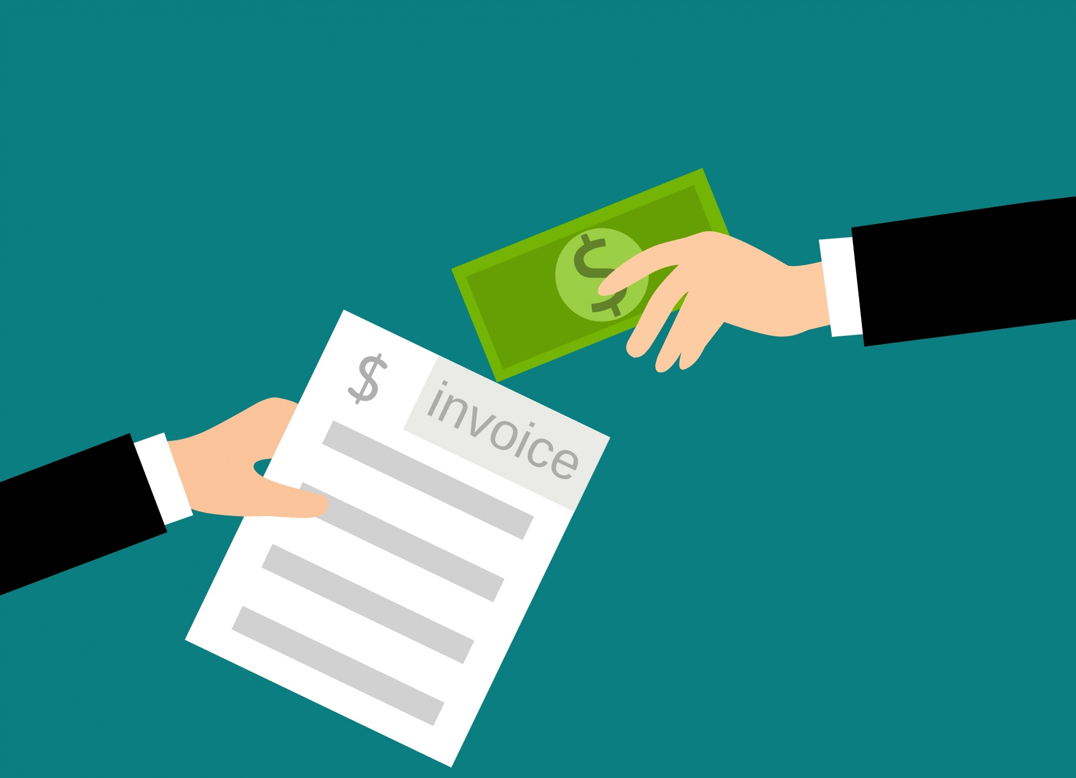
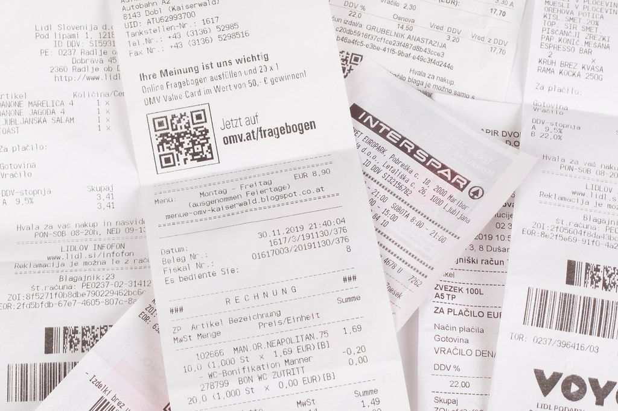
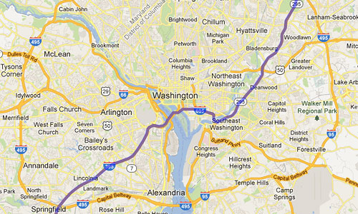



Step 15: Attach supporting documentation and save.
Examples:
Quotes
Receipts
Maps
E-Mail Correspondence
Bill of Lading
Invoices
This Photo by Unknown Author is licensed under CC BY-SA

Slide 18
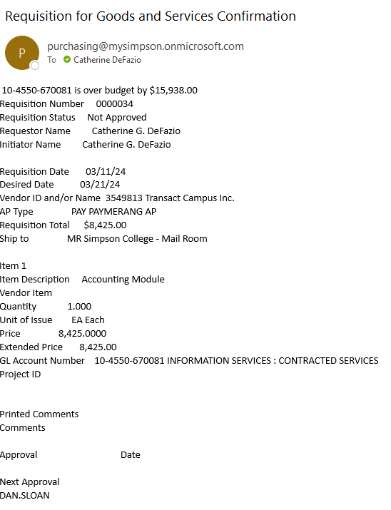
Step 16: You will receive an automated e-mail detailing your request.

Slide 19
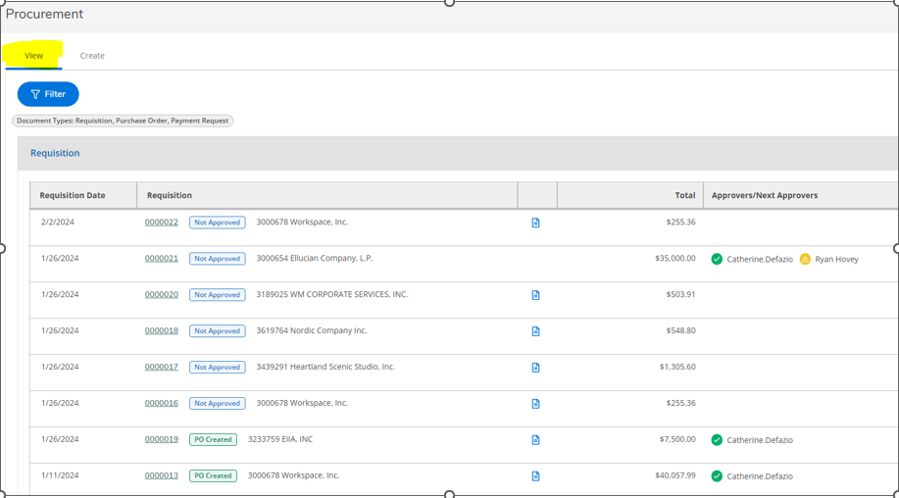
Step 17: A summary of your requests will be on the main page of the Procurement screen. You can see who has already approved and who is next in line.

Slide 20


From there: Requisitions go to the Business Office for PO Creation. Automated E-mails will be sent each step of the way. Once a PO is created, orders can be placed.

Slide 21
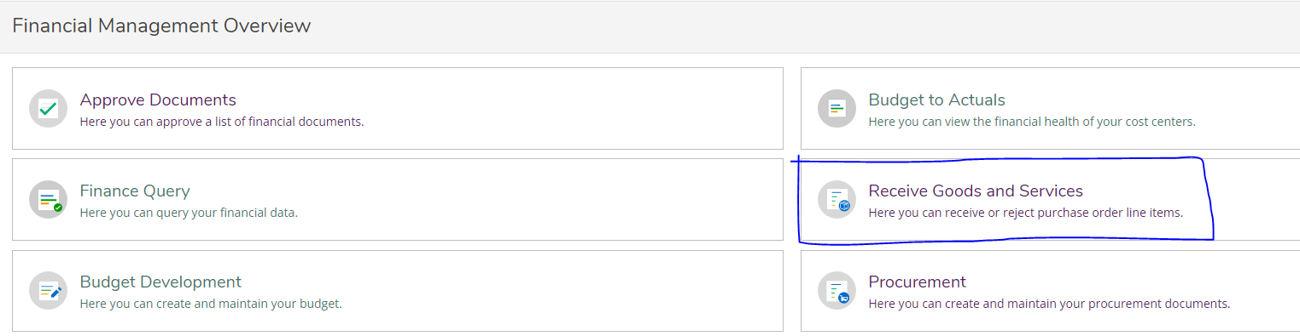
Step 18: Goods/Services need to be received.
This step is completed once the PO is created, and goods and services have arrived.
Go into Self-Service
Click on Financial Services
Click on Receive Goods and Services

Slide 22
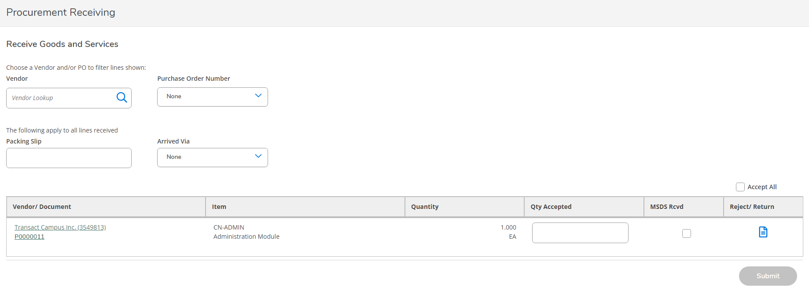
Step 19: Complete the screen. All items must be received separately, you cannot select “receive all.” Only select “MSDS Rcvd” if this is accurate. Not everything will require this.
Invoices CAN NOT be paid until all goods/services have been received.

Slide 23
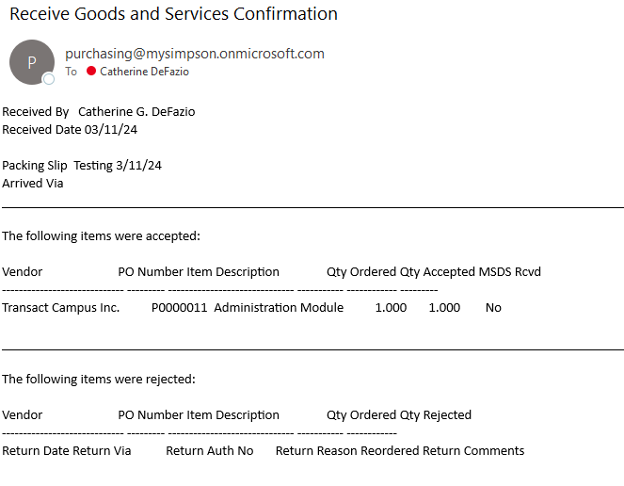
Step 20: You will receive an automated e-mail once goods/services have been received.

Slide 24
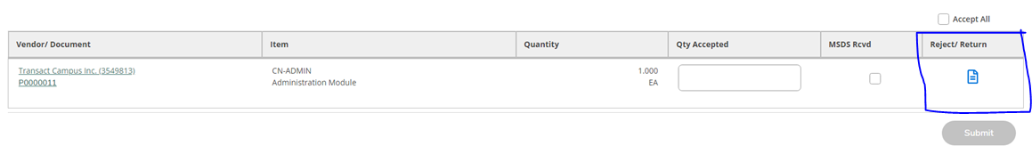
If you need to reject an item: Go into the receiving screen like you did before. Select the blue “page” under Reject/Return.

Slide 25
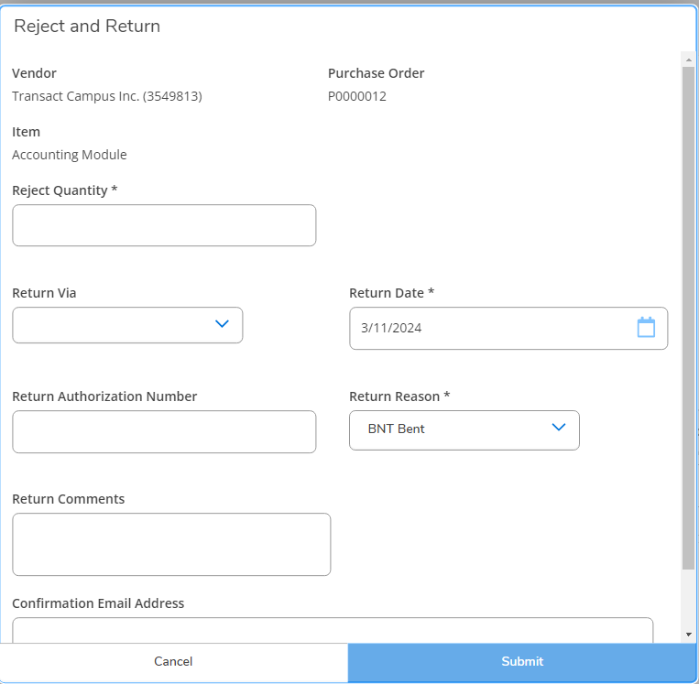
Fill out the form with as much detail as possible and submit.

Slide 26
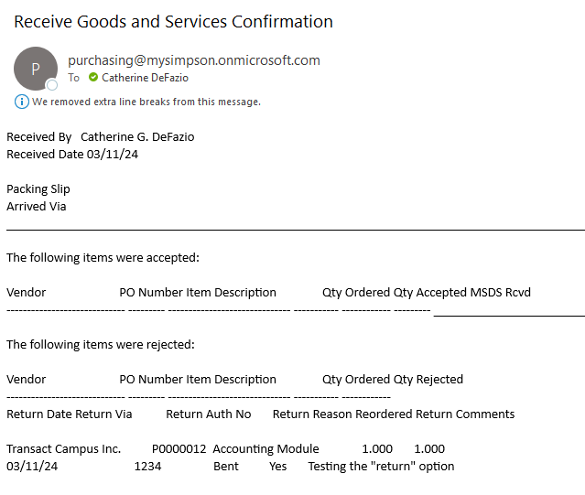
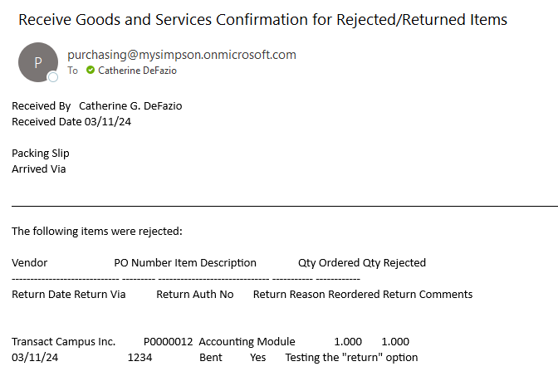
Examples of automated e-mails you might receive:

Slide 27
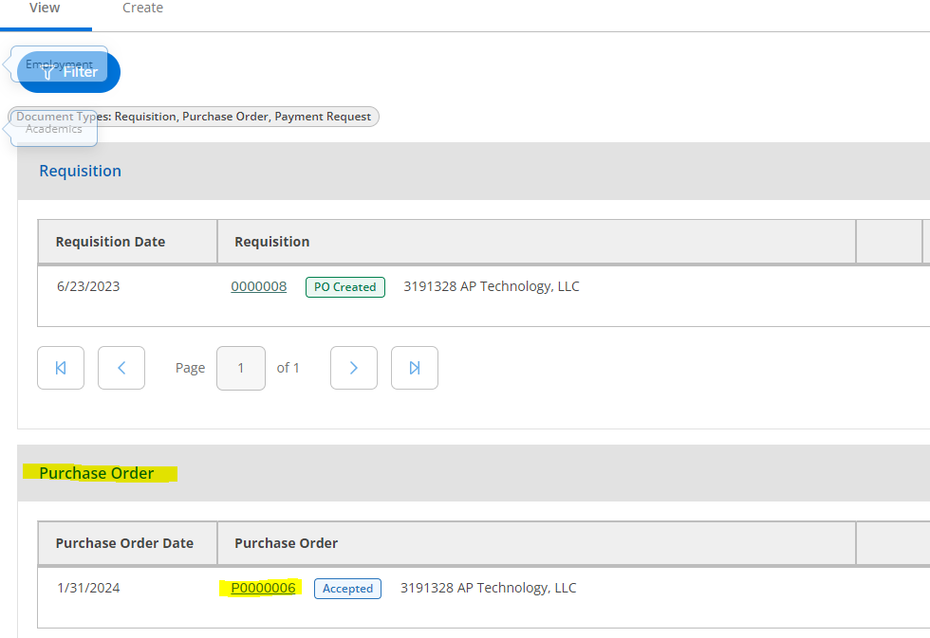
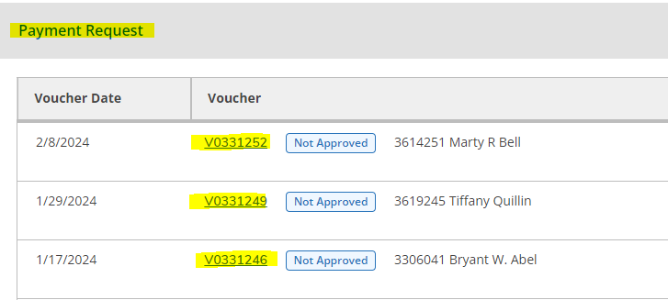
What to do with invoices after they have been received:
Invoices need to be sent to Accounts Payable with the PO number written on top of it.
Payment Requests need to have the Voucher Number that is assigned written at the top, and complete with all documentation.

Slide 28
Prepay Accounts
10-0015-115100
Definition of Prepaid expense: is an asset on the balance that results from a business making payments for goods and services to be received in the future.
Examples of Prepaid expense: memberships, maintenance contracts, subscriptions, insurance contracts

Slide 29
All expenses are Current Unrestricted
In other words- all expenses must be paid out of Fund 10 & Fund 63
Expense accounts start with 67xxxx

Slide 30

Deadlines:
All approved requestions will be turned into PO’s daily.
Invoices for received goods/services must be sent to Accounts Payable and will be paid based on due date.
Payment Requests must be approved and have all paperwork to A/P by Tuesday at 4:30pm for a same week check.
Reminder: Invoices need to have a PO number written at the top. Payment Requests must have a voucher number written on the request. These can be found in Self-Service. Invoices cannot be paid until goods/services have been received.

Slide 31

Reminders:
We cannot pay from a quote. We must have an official invoice before payment is processed.
A requisition is created when goods/services are needed. A Payment Request is used for travel/reimbursement.
New vendors will need to be set up Accounts Payable. A W-9 is required.
Travel/Reimbursement Checklist:
Completed Mileage/Travel Form
  Mileage Figured Correctly (.67/mile)
      Copies of ALL receipts
      Gas, Hotel, Rideshare, Flights, Food, Registration, supplies, etc.
Copy of map confirming distance traveled (only needed for mileage reimbursements)
Approved by all required parties
Correct GL listed

Slide 32
Please reach out with any questions you might have.
Jessica Danielson: Jessica.Danielson@simpson.edu Ext: 1317
Thank You.

