Slide 1
Training for Windows Only

Slide 2
What is OneDrive?
Storage for files
Saved in the cloud (no physical server on site like fileserve)
1TB of available space per user
Share files with anyone internal or external

Slide 3
How to Setup OneDrive
Go to Start and Programs
Select OneDrive for Business (if you do not have this option contact ITS)
Window will pop up saying where the files will be saved locally
Keep the default settings and click Cancel

Slide 4
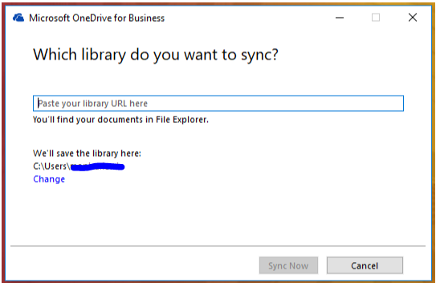

Slide 5
How to Setup OneDrive
Go to Start and Programs
Select OneDrive
Window will pop up saying where the files will be saved locally
Keep the default settings
Next in the lower right corner click on the UP arrow
Then select the OneDrive icon

Slide 6
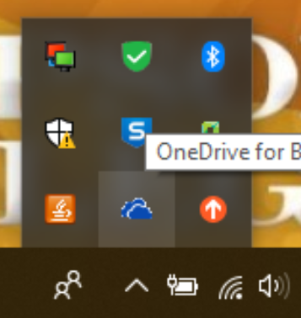

Slide 7
How to Setup OneDrive
Go to Start and Programs
Select OneDrive
Window will pop up saying where the files will be saved locally
Keep the default settings
Next in the lower right corner click on the UP arrow
Then select the OneDrive icon
Next One Drive is ready to sync and select the Sync Now button

Slide 8
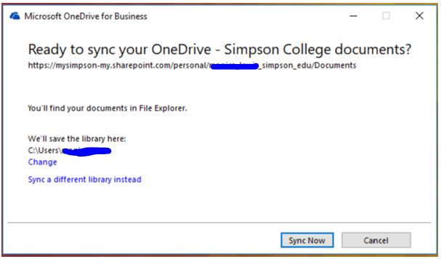

Slide 9
How to Setup OneDrive
Go to Start and Programs
Select OneDrive
Window will pop up saying where the files will be saved locally
Keep the default settings
Next in the lower right corner click on the UP arrow
Then select the OneDrive icon
Next One Drive is ready to sync and select the Sync Now button
After the sync is finished. OneDrive-Simpson College will show in your quick access pane in File Explorer

Slide 10
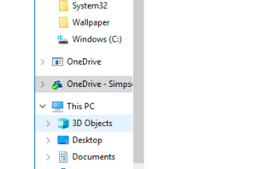

Slide 11
How to Setup OneDrive
Go to Start and Programs
Select OneDrive
Window will pop up saying where the files will be saved locally
Keep the default settings
Next in the lower right corner click on the UP arrow
Then select the OneDrive icon
Next One Drive is ready to sync and select the Sync Now button
After the sync is finished. OneDrive-Simpson College will show in your quick access pane in File Explorer
Next start to copy and paste files from anywhere on the PC to the OneDrive – Simpson College folder

Slide 12
How to Share a File
Open up your OneDrive – Simpson College folder
Navigate to the file or folder you want to share
Right click and select the Share

Slide 13
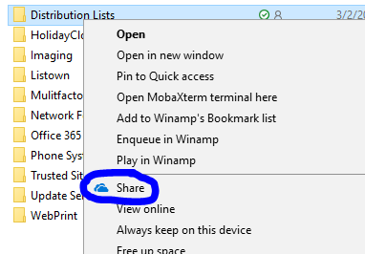

Slide 14
How to Share a File
Open up your OneDrive – Simpson College folder
Navigate to the file or folder you want to share
Right click and select the Share
A window will show wanting you to add an email address
You can add as many email addresses as you like or
Click Copy Link to send a link to email addresses
Click Outlook to take you to the Outlook App to send the link
Click More Apps to use other apps to share the file or folder

Slide 15
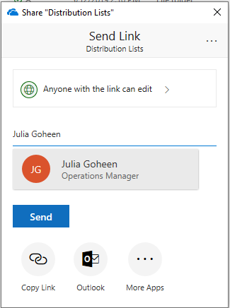

Slide 16
The End

