Slide 1
Slido
Melissa Daniels, Instructional Designer

Slide 2
Agenda
What is Slido?
Why is Slido a good add for your class?
Possible scenarios for Slido
How to set up

Slide 3
Slido – What is it?
A web-based platform that lets faculty engage with students (or other participants) with live polls and quizzes
Accessible via a web browser on any type of device
No app or registration needed for participants – they just type in the event code or scan a QR code to access the poll/quiz

Slide 4
What can you do by using Slido?
With Slido, users can:
Gather questions from a large group of people quickly and efficiently
Filter inappropriate questions if necessary
Brainstorm ideas
Conduct live polls
Create interactive and gamified quizzes
Create easy openers/icebreakers for your class!

Slide 5
Why is Slido a good product to try in your class?
Adds an interactive component to your lesson
Can be integrated directly into a PPT presentation
Students don’t need to register/sign up for Slido – they just use a code
Polling students and interactive quizzes during a lesson are easy ways to check for understanding or even grow as a community
Gives students who might be too scared to speak up in class an opportunity to participate and show their voice

Slide 6
Slido can be used in other ways as well!
If you have a guest speaker, you could use Slido as a way to gather questions that your audience wants to ask.
This could work in-person or for a virtual webinar/Zoom speaker
Slido has already been used for a guest speaker presentation this year, with great success!

Slide 7
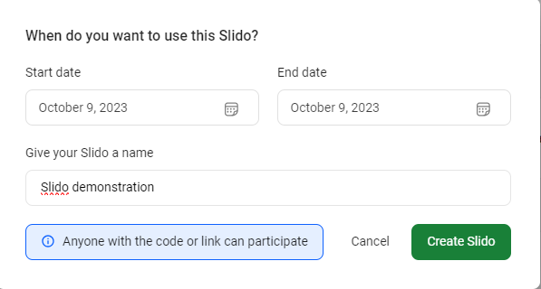
How to set up:
There is a basic free plan that allows unlimited “events” - opportunities for up to 100 participants to log in and answer poll questions, take an interactive quiz, or partipate in a Q&A session
Just click “Create Slido” and select the dates you’d like it to be used – give it a name – and create the Slido. Easy!

Slide 8
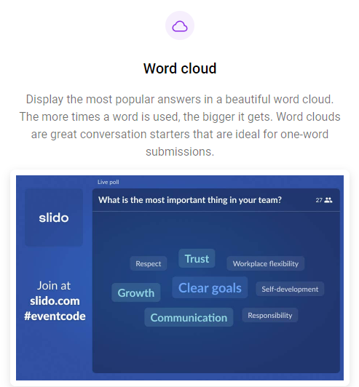
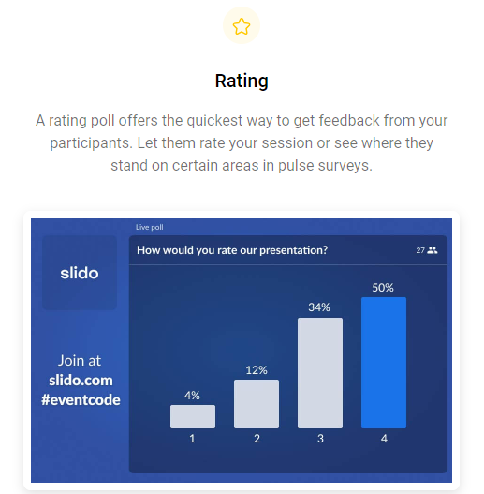
When polling students, there are several different template options – pick whichever one you’d like!

Slide 9
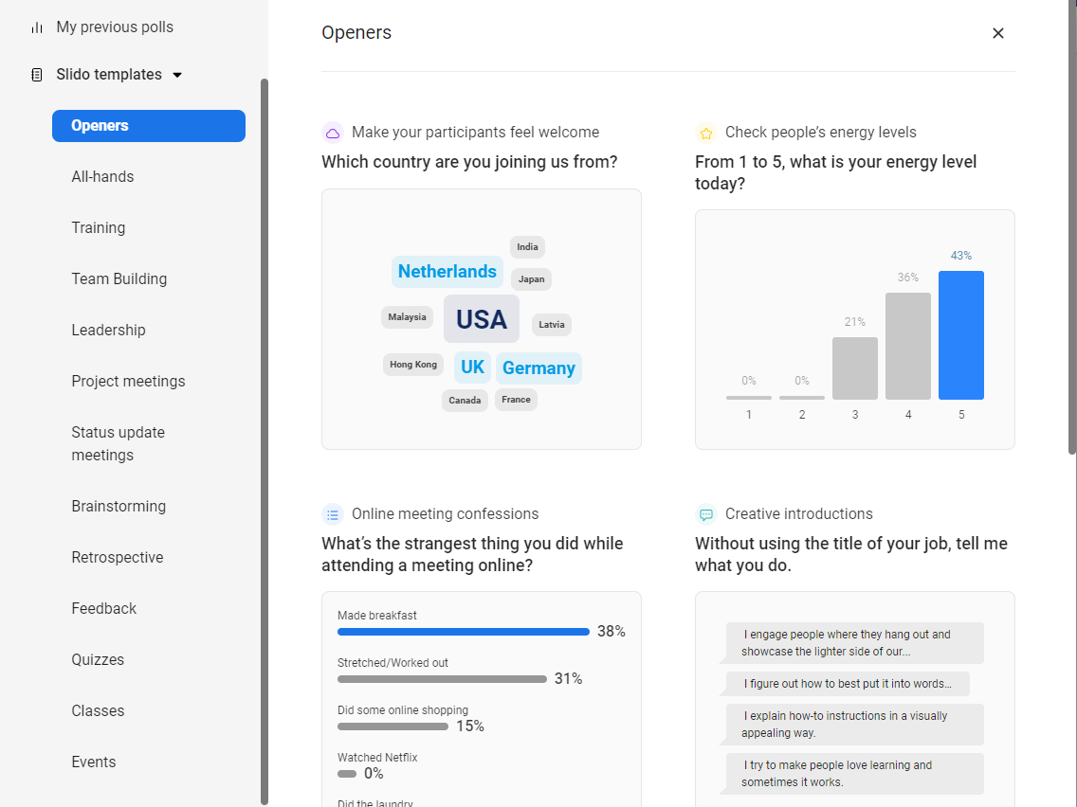
When polling students, there are several different template options – pick whichever one you’d like!

Slide 10
Ask your question… and save!

Slide 11
Ask your question… and save!

Slide 12
Also an option: creating quizzes!

Slide 13
On your screen, you can see the poll from your side, as well as what it looks like on the phone of your audience

Slide 14
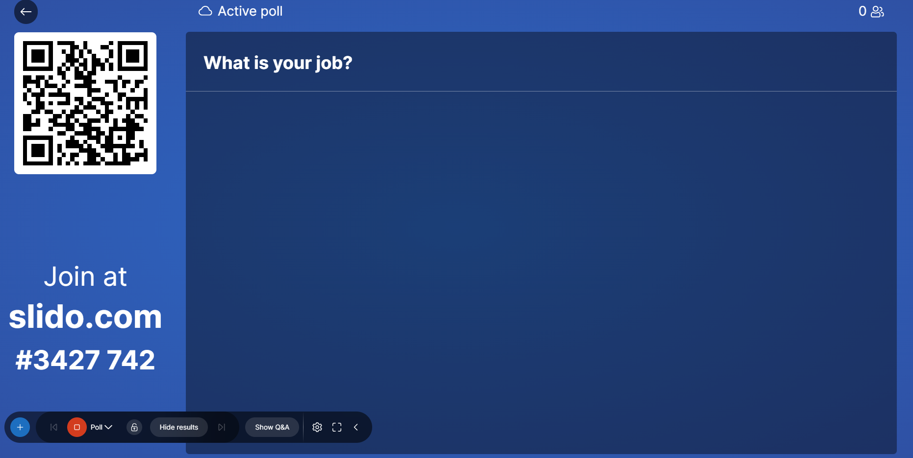
Couple different options: from Slido, click “Present”:

Slide 15
OR (Slightly more advanced): Go to “Settings”, “Integrations”, then PowerPoint, and download it so you can incorporate it right into your presentations!

Slide 16
Fun fact: I have now downloaded Slido and am presenting with Slido right now!

Slide 17
What is your job?
ⓘ Start presenting to display the poll results on this slide.

Slide 18
Who is the horror movie villain made famous in the movie "Halloween" featuring Jamie Lee Curtis?
ⓘ Start presenting to display the poll results on this slide.

Slide 19
Thank you!!
melissa.daniels@simpson.edu

